Slide 1
Deployment
Ahmed Hesham

Slide 2
What Is Deployment?
Running an application on a target device
Types of deployment:
  Local
  Remote

Slide 3
Why Deploy Applications Remotely?
Part of serverless architecture
Abstracts work needed to managing servers
Dependencies should be packaged with the application

Slide 4
Issues with deployment
No guarantee on where application will be deployed
Hardware support is not guaranteed:
  Different CPU architectures (x86 vs ARM)
  Special hardware e.g. GPUs
Application may be hosted locally to cater for special hardware requirements

Slide 5
Packaging Applications
There are two main methods of packaging applications:
  Virtualization
    Hosted
    Bare Metals
  Containerization

Slide 6
What Is Virtualization?
Running a virtual instance of a computer
Requires an OS inside the instance
Pros:
  High security (CPU level)
  Multiple OS per machine
Cons:
  Large in size

Slide 7
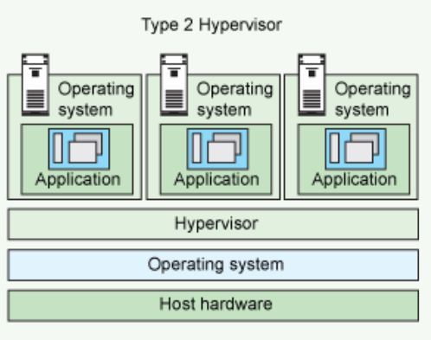
What Is Hosted Virtualization?
Uses a Hypervisor to translate system calls between guest and host OS
Example: Virtualbox

Slide 8
Hosted Virtualization Pros/Cons
Pros:
  Greater host platform support through translation layer (Hypervisor)
  Allows for different architectures OS
Cons:
  Limited CPU functionality
  Requires a hosting OS to run guest OS

Slide 9
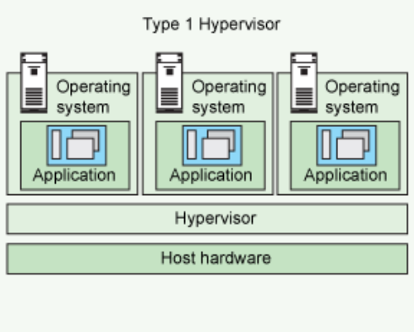
What Is Bare Metals Virtualization?
Direct access to hardware
Hypervisor provides drivers needed for hardware
Example:
  Linux KVM
  Windows Hyper-V

Slide 10
Bare Metals Pros/Cons
Pros:
  Higher performance than hosted
  Set allocated hardware, no sharing
Cons:
  Management overhead
  Guest is limited by hardware architecture

Slide 11
Why Virtualize?
Application is dependent on a specific OS
OS must be packaged with application

Slide 12
What Is Containerization?
OS level virtualization
Applications partitioned in isolated user spaces
Examples:
  Docker
  Kata Containers
  Apache Mesos

Slide 13
Containerization Pros/Cons
Pros:
  Lightweight, no OS present
  Scheduled by OS as a normal process
Cons:
  Depends on OS to provide isolation
  Less secure than VM

Slide 14
Docker
A containerization solution
Uses Linux kernel containers (LXC) to operate
Modes of operation:
  Container Host: this container uses the libraries and tools provided by the host OS normally
  Container OS: this container comes packaged with the tools of a specific OS to use as a dependency for example: CentOS on an Ubuntu host

Slide 15
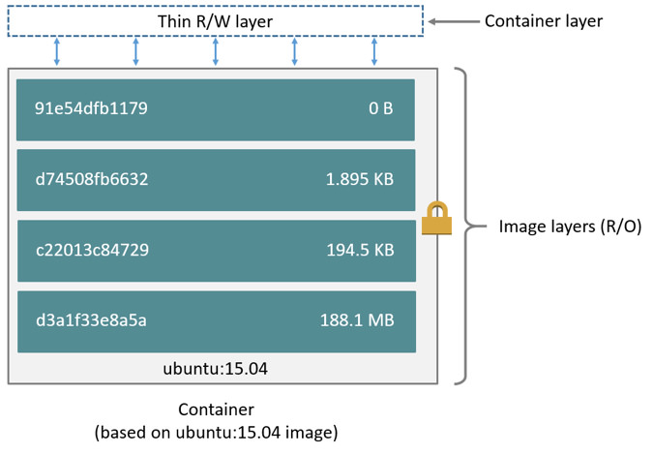
How Docker Works
A Docker image is a set of layers stacked up to form the container
Each layer is Read Only with the exception of the last layer for writing small files

Slide 16
How Docker Works – continued
Reduces layer duplication on disk through using Copy On Write (CoW)
Docker works best with CoW filesystems e.g. BTRFS, ZFS and AppleFS
In the case of other filesystems being used, OverlayFS is used to mimic CoW

Slide 17
What Is OverlayFS?
Union mount filesystem: can mount multiple directories to appear as one
It emulates CoW by separating directories into layers:
  Lower layer: not modified
  Upper layer: stores any new files
  Overlay layer: temporary working layer

Slide 18
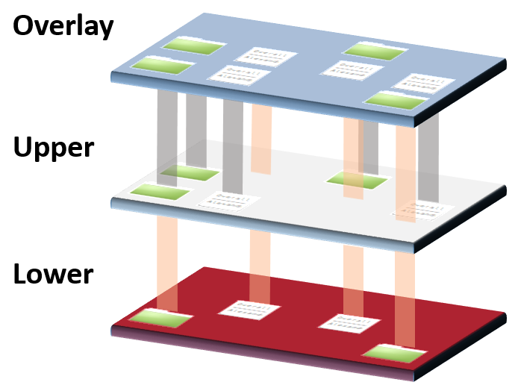
OverlayFS – continued

Slide 19
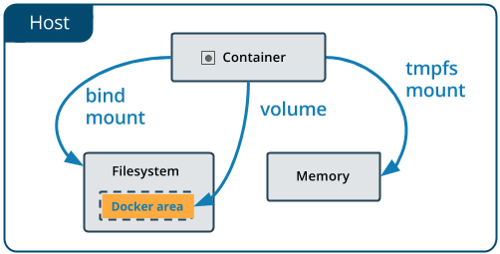
Docker Volumes
Containers have only a limited writing space
To allow for larger storage areas, volumes are used
Volumes can be shared between host machines as they are managed by Docker itself

Slide 20
Use Case Of Docker Volumes
Media Server
Databases

Slide 21
Managing Docker Containers
Server can host hundreds of Docker containers
Unfeasible to manage each by hand
Orchestration tools automate management of containers

Slide 22
What Is Kuberenetes?
An open source container orchestration tool developed by Google
Can replicate or migrate containers to other servers depending on the resource requirements
Clusters servers to view them as one instance

Slide 23
Kubernetes Terminology
Pods:
  Most basic unit of computation
  Can host multiple containers
  Guarantees colocation of containers for network access
Services:
  Set of pods that together form an application
  Example: media micro-service might be composed of media server and media micro-service

Slide 24
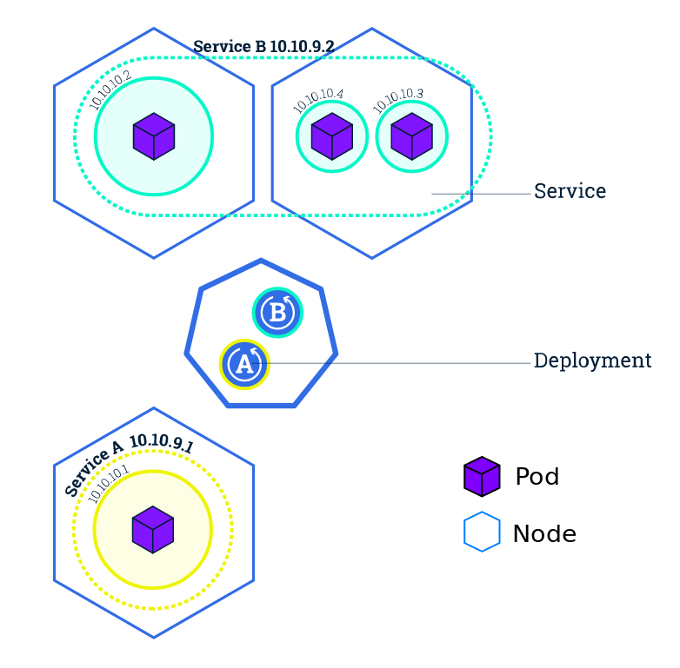
Kubernetes Architecture

Slide 25
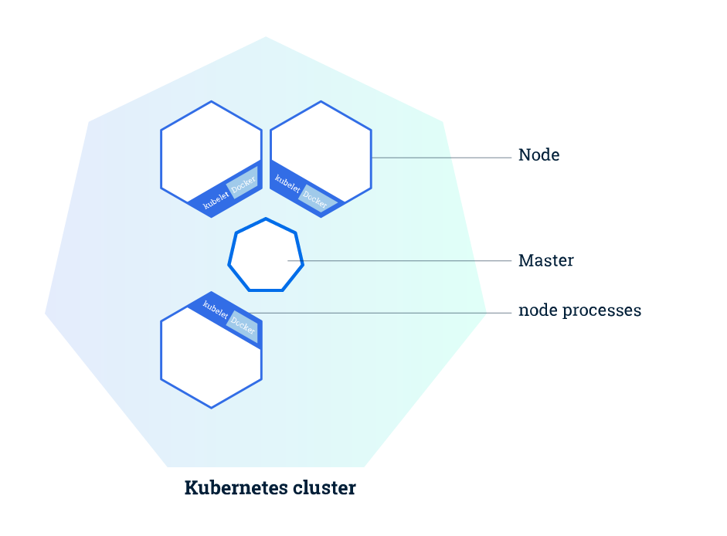
Kubernetes Cluster
Master and worker architecture
A node can be VM or a physical computer
Each node has:
  Kubelet: interface to node
  Docker interface

Slide 26
Deploying On Kubernetes
Allows developers to specify the resources per container to be used
Master would find the most appropriate node to be used and deploy on it
If a node fails, the master has a registry of deployed pods and redeploys them on live nodes (self-healing)

Slide 27
Rolling Updates
Allows for rolling updates to happen to allow for zero down time
Instances are updated incrementally till all the instances are updated

Slide 28
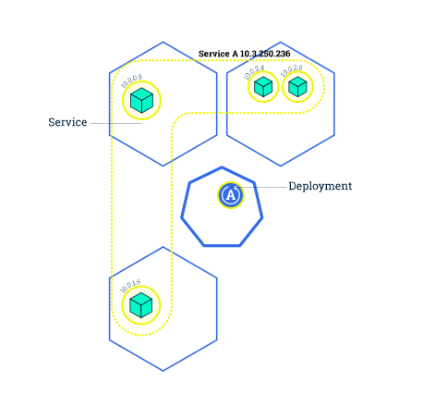
Rolling Updates – I

Slide 29
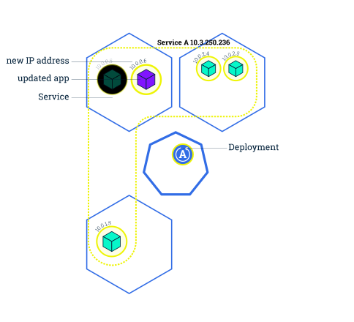
Rolling Updates – II

Slide 30
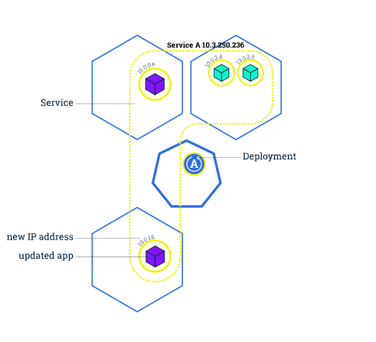
Rolling Updates – III

Slide 31
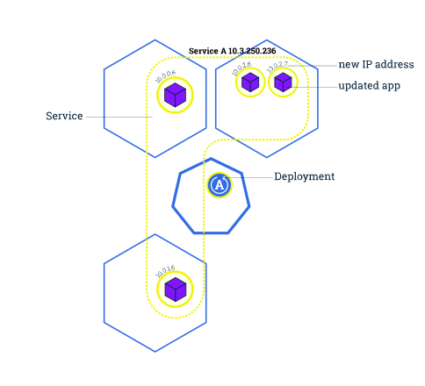
Rolling Updates – IV

Slide 32
Scaling With Kubernetes
Kubernetes provides two IPs to access an instance:
  Public IP: accessed through the internet
  Private IP: only visible on the local subnet between instances
When replicating:
  New private is assigned to the instance
  Public IP unchanged
  Proxy routes connections internally

Slide 33
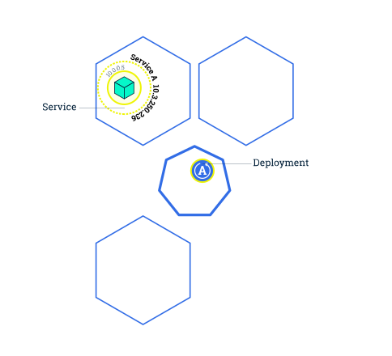
Scaling With Kubernetes

Slide 34
Any questions?

